Slide 1
Traffic Flow Prediction for London Road Networks Using Deep Learning

Slide 2
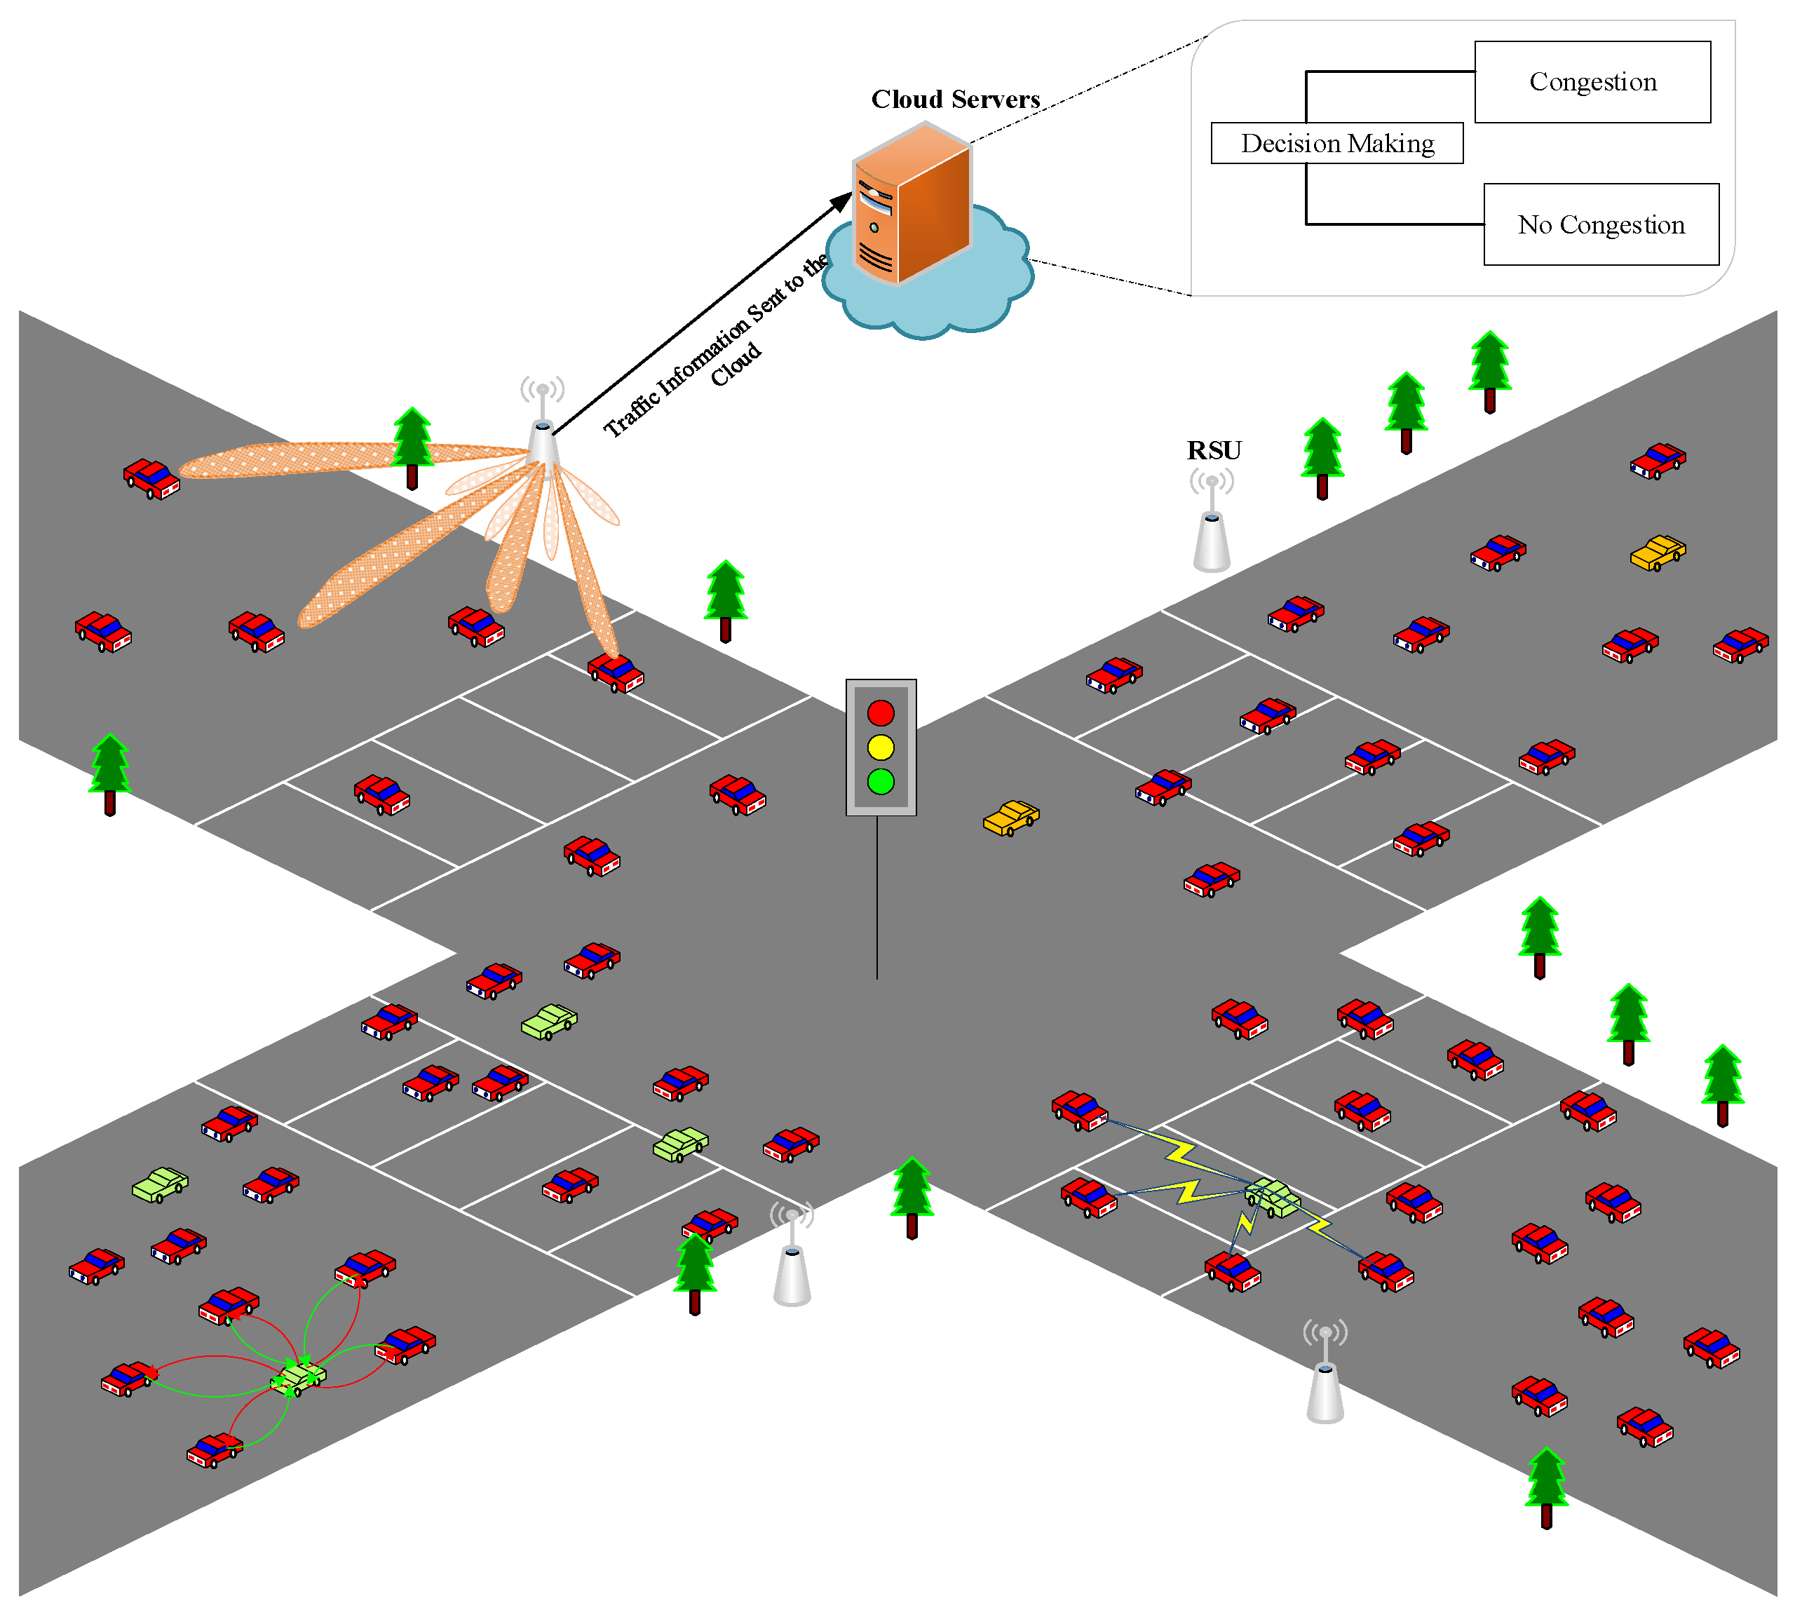
Traffic Flow Networks

Slide 3
Traffic Flow Road Networks
Traffic Flow Prediction can be considered a type of time series prediction task.
In time series prediction, the goal is to forecast future values of a sequence of data points based on historical observations. Traffic flow prediction involves analyzing historical traffic data to predict future traffic patterns and congestion levels on London's road networks.
The historical traffic data, which consists of vehicle counts, speeds, congestion patterns, and other relevant factors collected over time, forms a time series dataset. By applying deep learning techniques such as recurrent neural networks (RNNs), long short-term memory (LSTM) networks, and convolutional neural networks (CNNs), the project aims to learn patterns and dependencies within the time series data to make accurate predictions of future traffic flow.

Slide 4
Background
Traffic congestion is a pervasive issue in urban areas, impacting travel time, fuel consumption, and overall quality of life. As cities grow, managing traffic becomes increasingly challenging. Accurate traffic flow prediction is essential for efficient traffic management, route planning, and infrastructure development.
Accurate traffic flow prediction stands as a cornerstone of modern urban transportation management, offering transformative potential in alleviating congestion, reducing environmental impacts, and enhancing the overall quality of life in rapidly growing urban environments. Embracing innovative predictive analytics methodologies and leveraging emerging technologies can empower cities to confront the challenges posed by traffic congestion and forge a path towards more sustainable, resilient, and livable urban futures.

Slide 5
Problem Definition
"This project aims to predict traffic flow for London’s road networks using deep learning techniques".
The specific problem i intend to address within the domain of deep learning is short-term traffic flow prediction for London’s road networks.
The problem of short-term traffic flow prediction within the realm of deep learning holds immense significance for urban mobility and transportation management. Here’s why:
1. Traffic Efficiency: Accurate predictions enable cities to optimize traffic flow, reduce congestion, and enhance overall transportation efficiency. Commuters benefit from shorter travel times and reduced stress.
2. Environmental Impact: Efficient traffic management contributes to lower emissions and a greener environment. Predictive models can guide policies for sustainable urban planning.
3. Safety: Real-time traffic flow predictions aid in preventing accidents and improving road safety. Timely rerouting can avoid hazardous situations.
4. Emergency Response: During emergencies (e.g., accidents, natural disasters), accurate predictions help emergency services allocate resources effectively.
5. Infrastructure Planning: Predictive models inform infrastructure development, such as road expansions, traffic signal optimization, and public transportation enhancements.
6. Economic Productivity: Smooth traffic flow supports economic activities by ensuring timely goods delivery, reducing business costs, and promoting commerce.
In summary, deep learning-based traffic flow prediction directly impacts daily lives, safety, the sustainable growth of cities , enhance traffic management, optimize routes, and improve overall urban mobility

